Slide 1
Exploration of Cache-Based Side-Channel Attacks in FPGA SoCs
Matteo Oldani
Under the supervision of
Dina Mahmoud
Dr. Mirjana Stojilović
19/01/2023

Slide 2
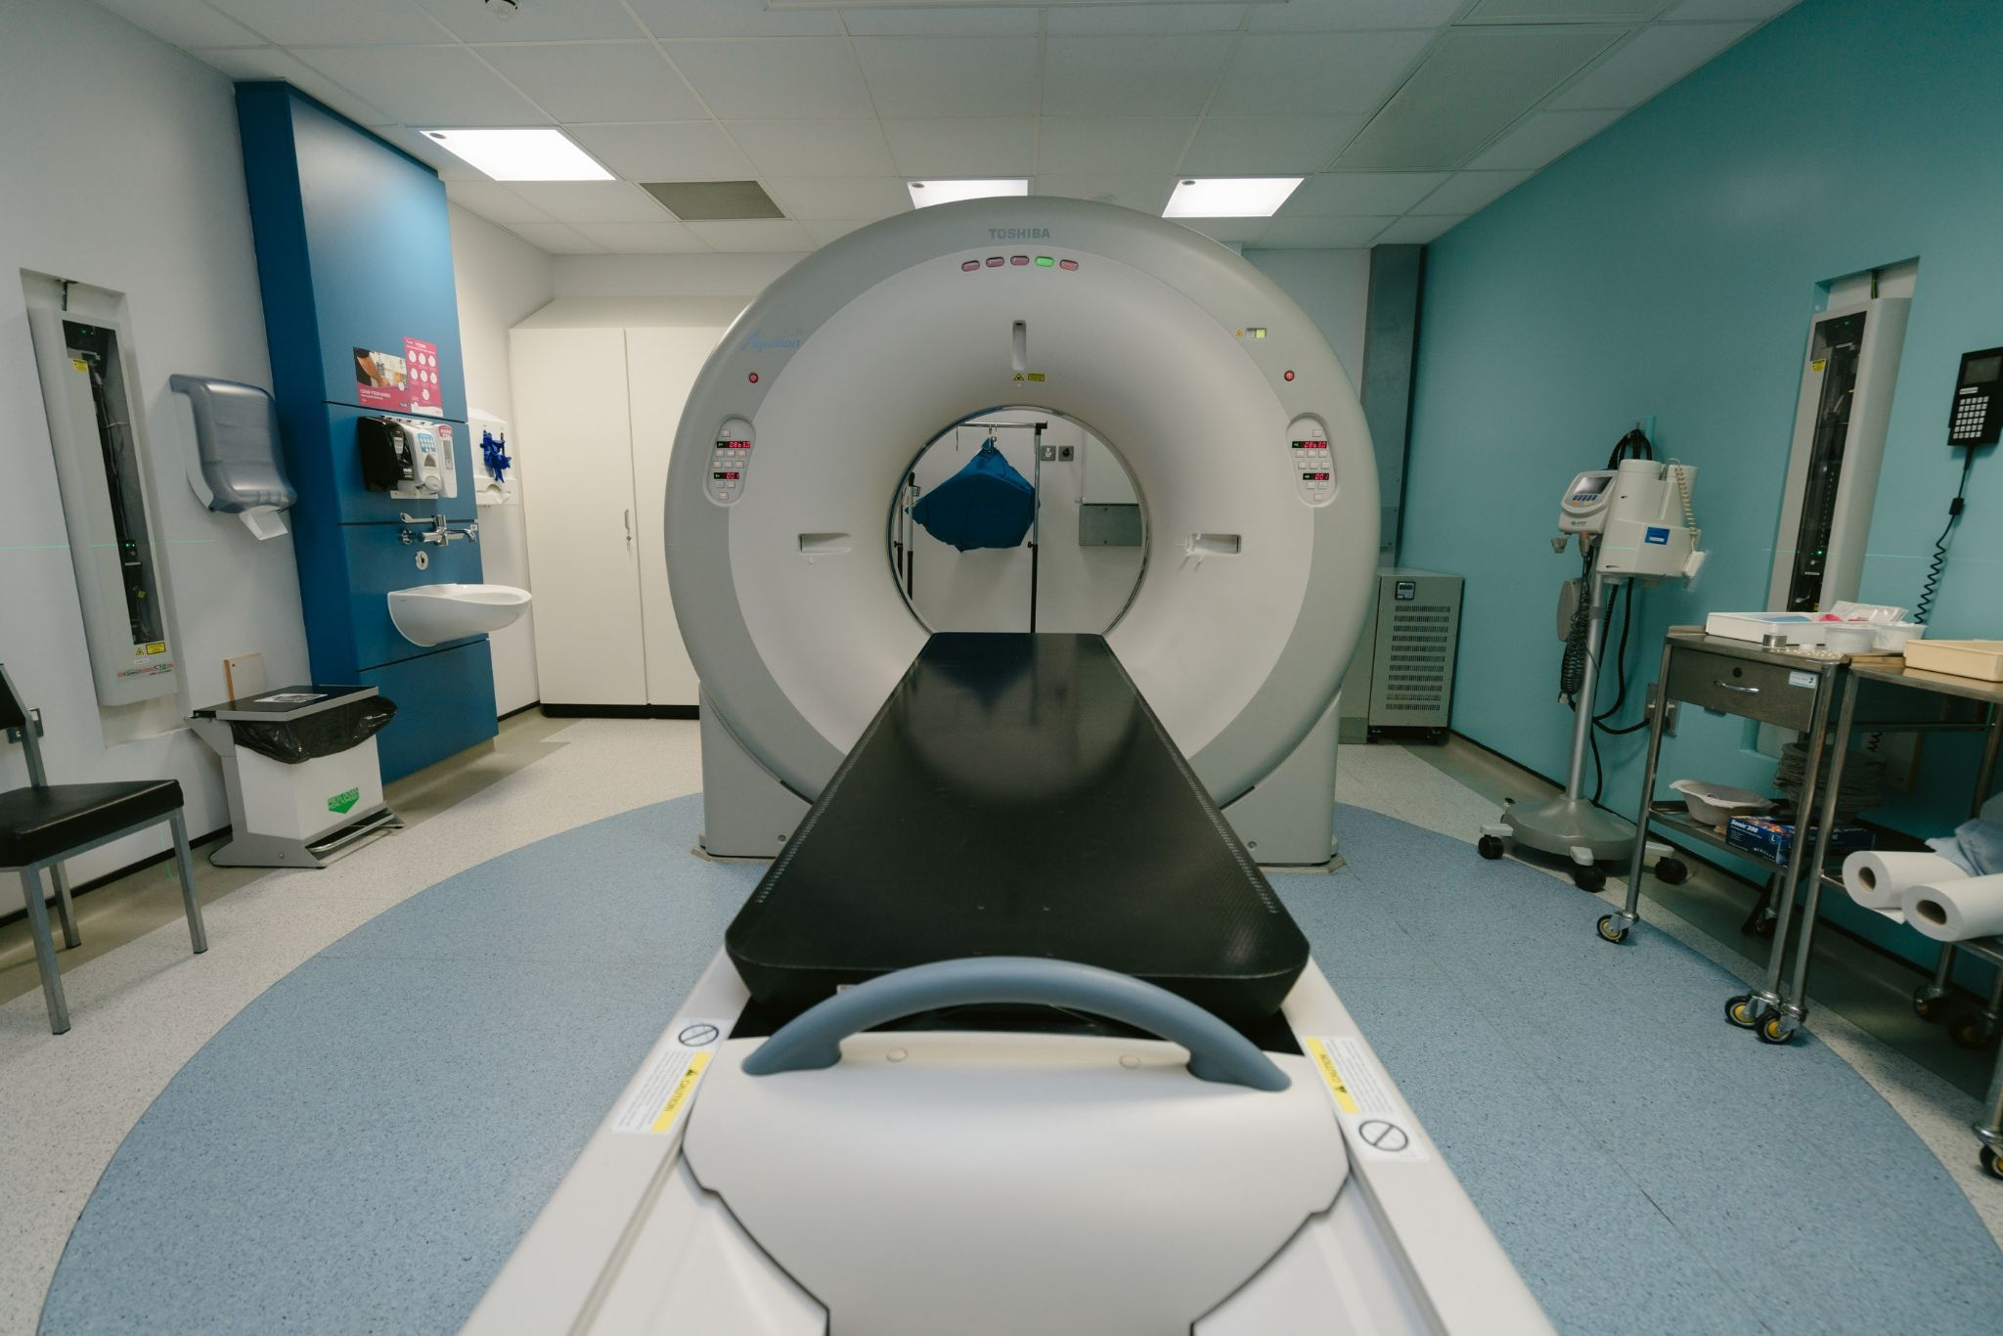
Introduction
Increasing demand for specialized hardware
High level of parallelism
Application in industry
Healthcare
Automotive
Aerospace
Notes:
Transation specifying that we attack this systems

Slide 3
Roadmap
Background
Cache attacks
AES T-Table implementation
Experimental Setup
Threat Models
Exploration
Conclusions

Slide 4

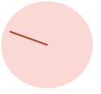
Cache Attacks
funct(secret_bit)
{
if(secret_bit == 1)
*addr1;
else
*addr2;
}
Attacker Core
Victim Core
funct(?)
Cache
addr1
Memory
addr2

Slide 5
Cache Attacks
Requirements:
Ability to time access
Ability to control the cache
Flush a cache line
Evict a cache line
Shared memory
Types of Cache Attacks:
FLUSH + RELOAD
EVICT + RELOAD
FLUSH + FLUSH
PRIME + PROBE
Notes:
Transition to AES explaining why we use AES

Slide 6
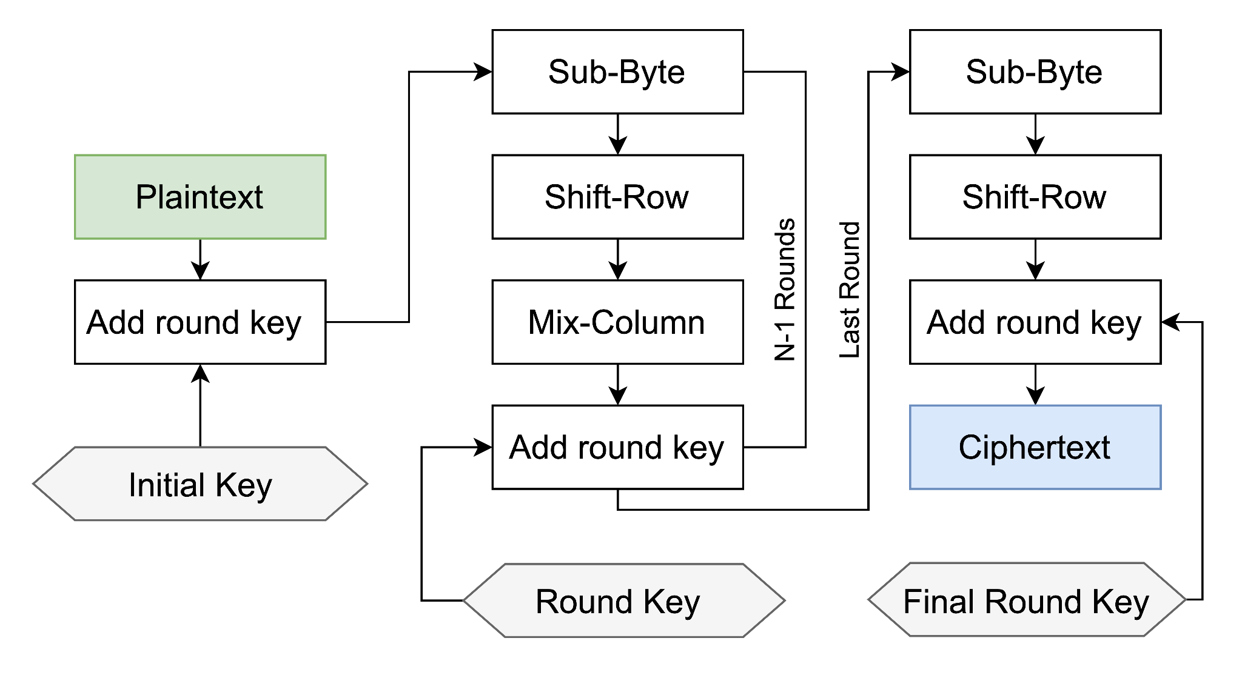
AES T-Table Implementation
AES Steps:
Add round key
Sub-Byte
Shift-Row
Mix-Column
AES 128 → 10 rounds

Slide 7
AES T-Table Implementation
T-Table is an optimized implementation of AES
AES steps are done using transformation tables
Each round is composed of 16 lookups
T-Table implementations of AES are vulnerable to side-channel attacks
Notes:
Check fault injection attack

Slide 8
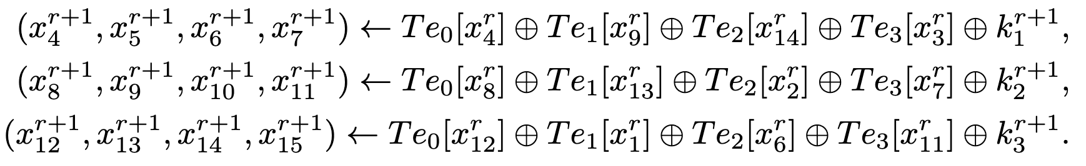
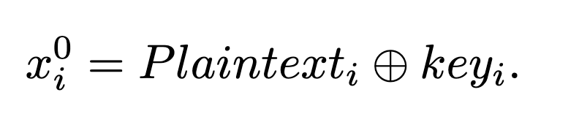
AES T-Table Implementation
AES encryption is done as follow:
where Te_{i} are the transformation tables used for encryption and:

Slide 9
Roadmap
Background
Experimental Setup
Threat Models
Exploration
Conclusions

Slide 10
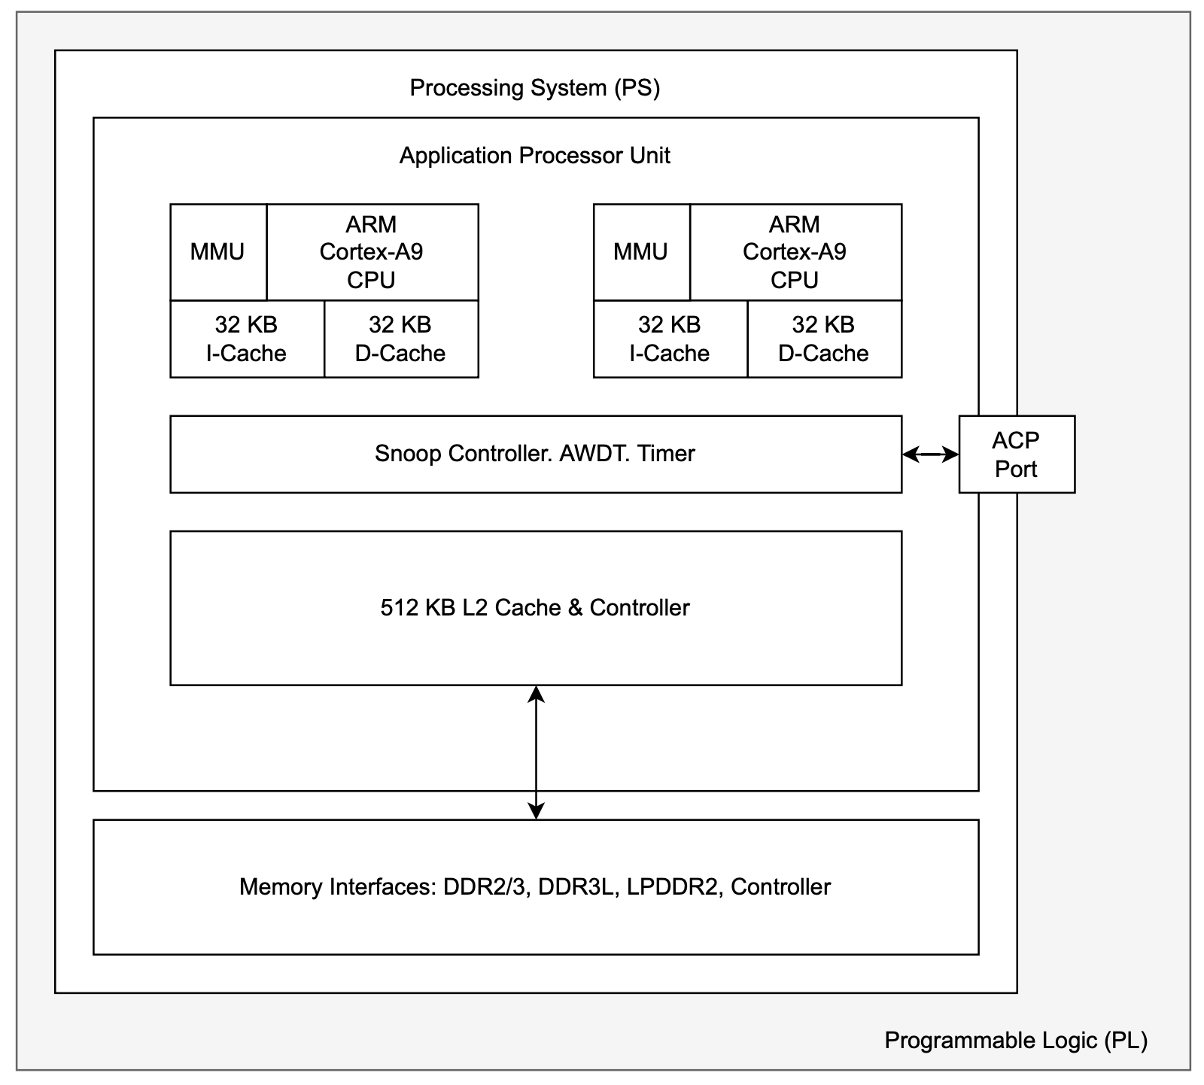
Experimental Setup
Zedboard Development Board
AMD Xilinx Zynq®-7000 SoC
Non-inclusive last-level cache (L2)

Slide 11
AXI Protocol
Versions
AXI4
AXI4-Lite
AXI4-Stream
Channels
Read Address Channel
Read Data Channel
Write Address Channel
Write Data Channel
Write Response Channel
Notes:
mention that it is a master slave protocol

Slide 12
Roadmap
Background
Experimental Setup
Threat Models
Exploration
Conclusions

Slide 13
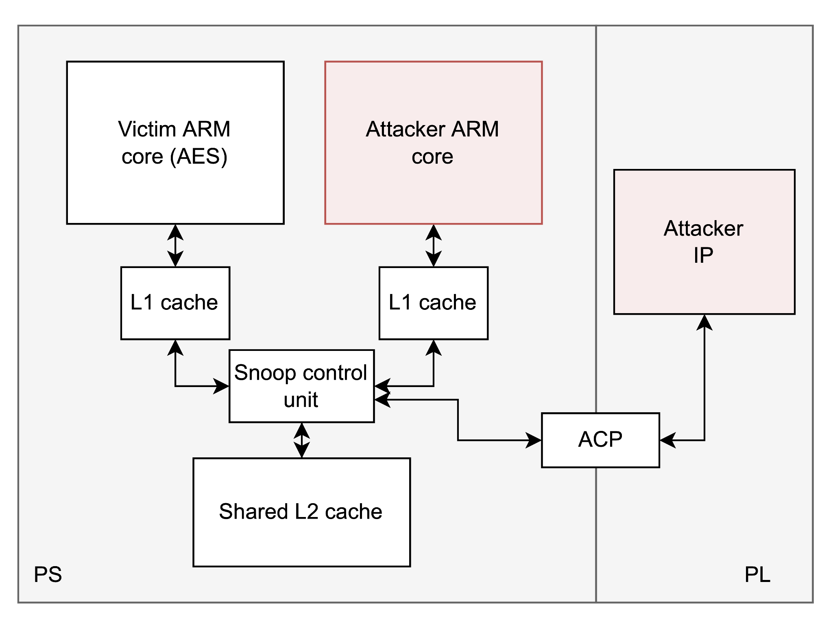
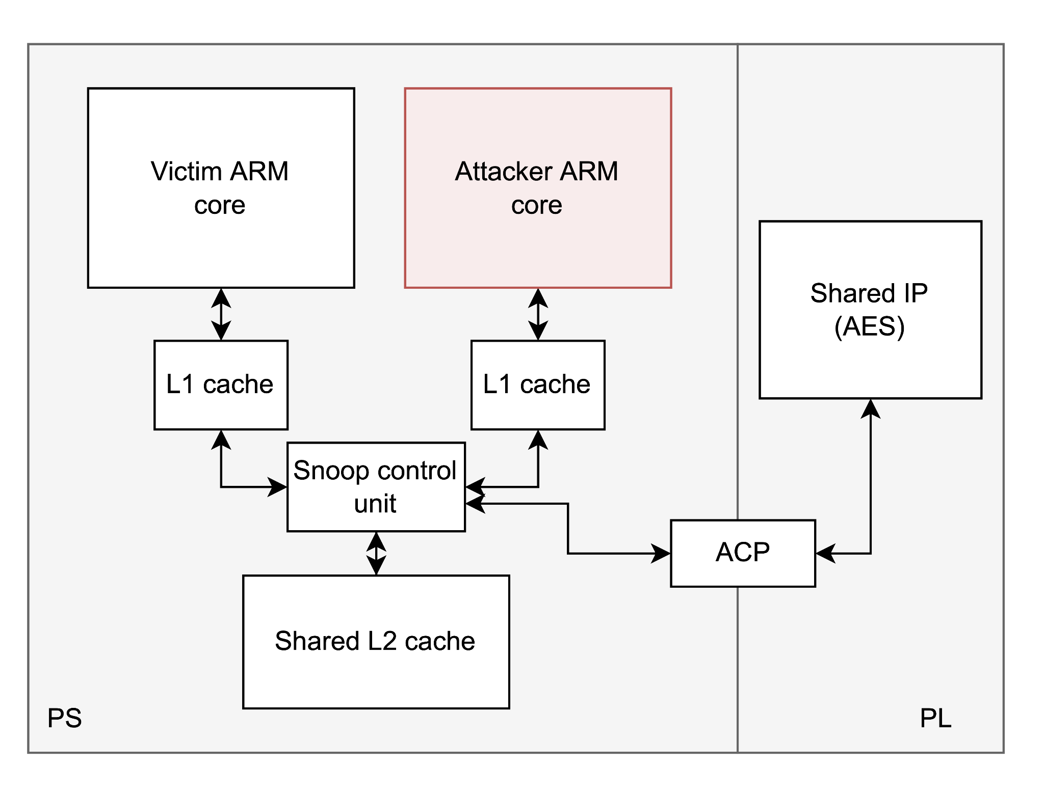
Threat Models
FPGA-to-CPU
CPU-to-FPGA

Slide 14
Roadmap
Background
Experimental Setup
Threat Models
Exploration
Read side-channel
Write side-channel
CPU to FPGA
Conclusions

Slide 15
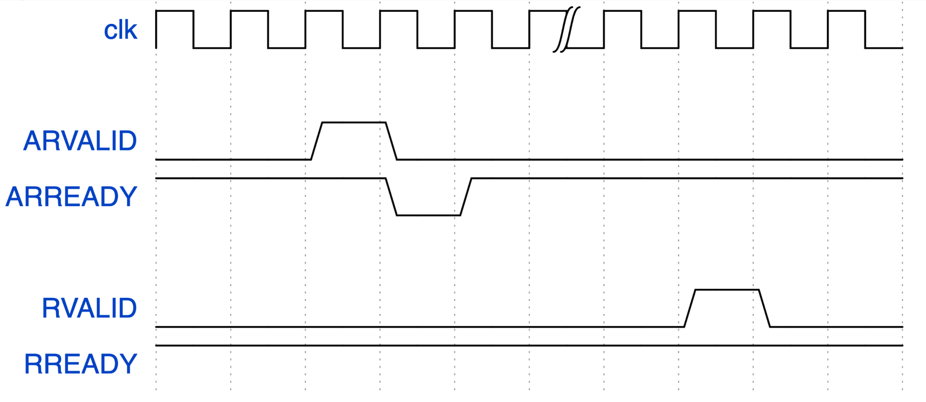
Timing Difference
The AXI Read handshake length depends on the position of data in the cache as shown by Bossuet et al.*
Data in L1 cache → 12 cycles
Data in L2 cache → 13 cycles
*Bossuet et al. “Performing Cache Timing Attacks from the Reconfigurable Part of a Heterogeneous SoC - An Experimental Study”, Applied Sciences 2021
Notes:
mention that the cycles are from the clock from the fpga side
say/add frequency used

Slide 16
Eviction
The WSTRB signal controls which byte is valid when a write transaction is issued from the FPGA side to the CPU one.
A cache line is invalidated from L1 if a write is issued to the same address.
To evict a cache line from L1 without changing its value, we can issue a write transaction with the WSTRB to b‘0000’.

Slide 17
Key Recovery Attack
Attack steps for a partial key recovery:
Consider a plaintext of 16 bytes. For every byte, test all the possible values while setting the remaining bytes in the plaintext at random.
Check if the table has its first 8 bytes in the cache. If so, this plaintext is kept in the candidates, otherwise, it is removed.
Iterate the process until the set of candidates is reduced to only 8 values.
Notes:
Shorten the sentences

Slide 18
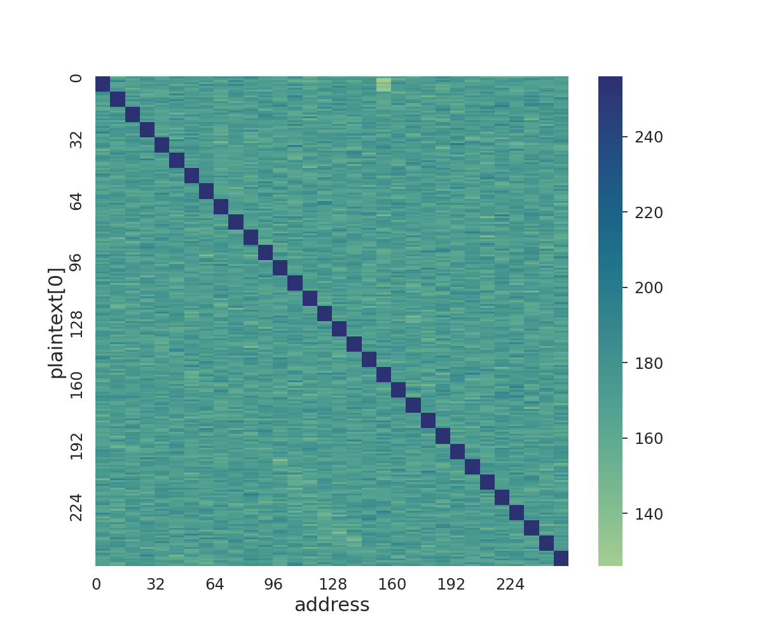
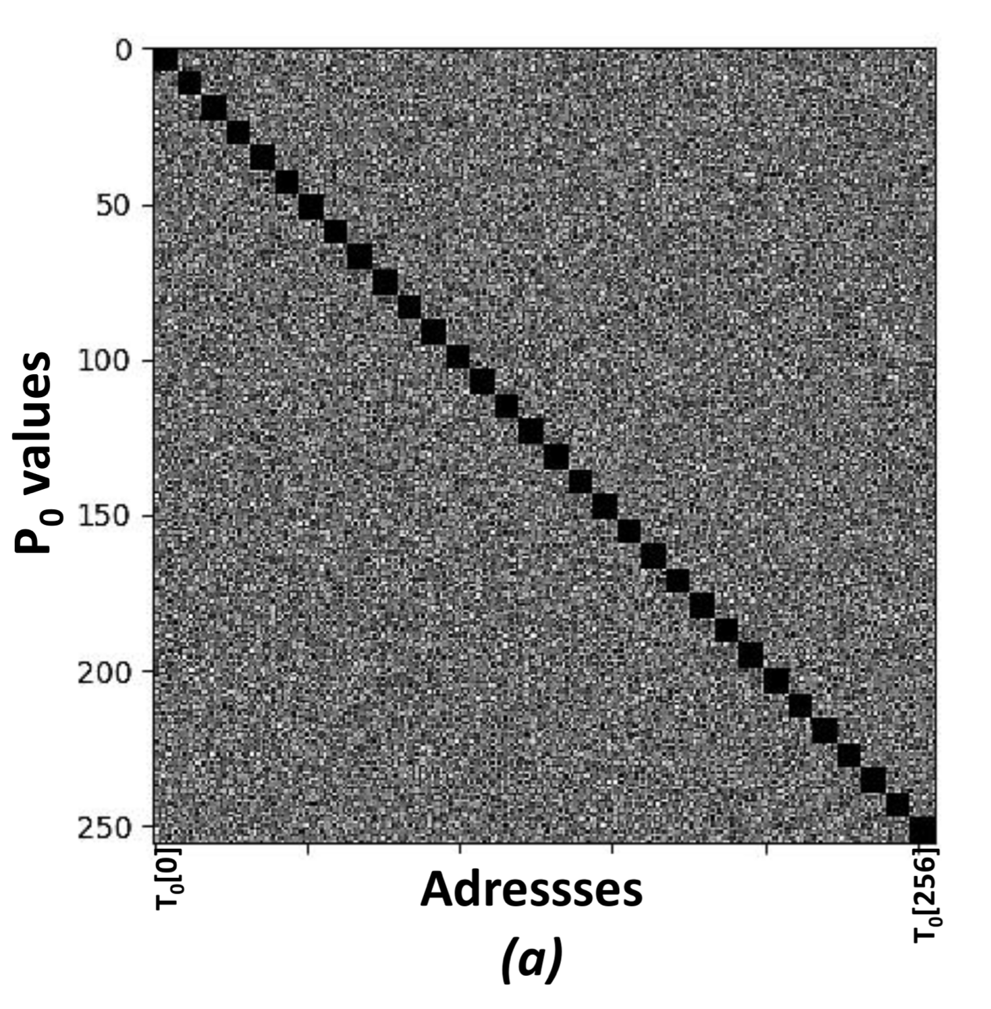
Read Channel Attack Results
Reference paper results
Our results
Notes:
mention the axis before speaking
mention that we are moving to the write channel

Slide 19
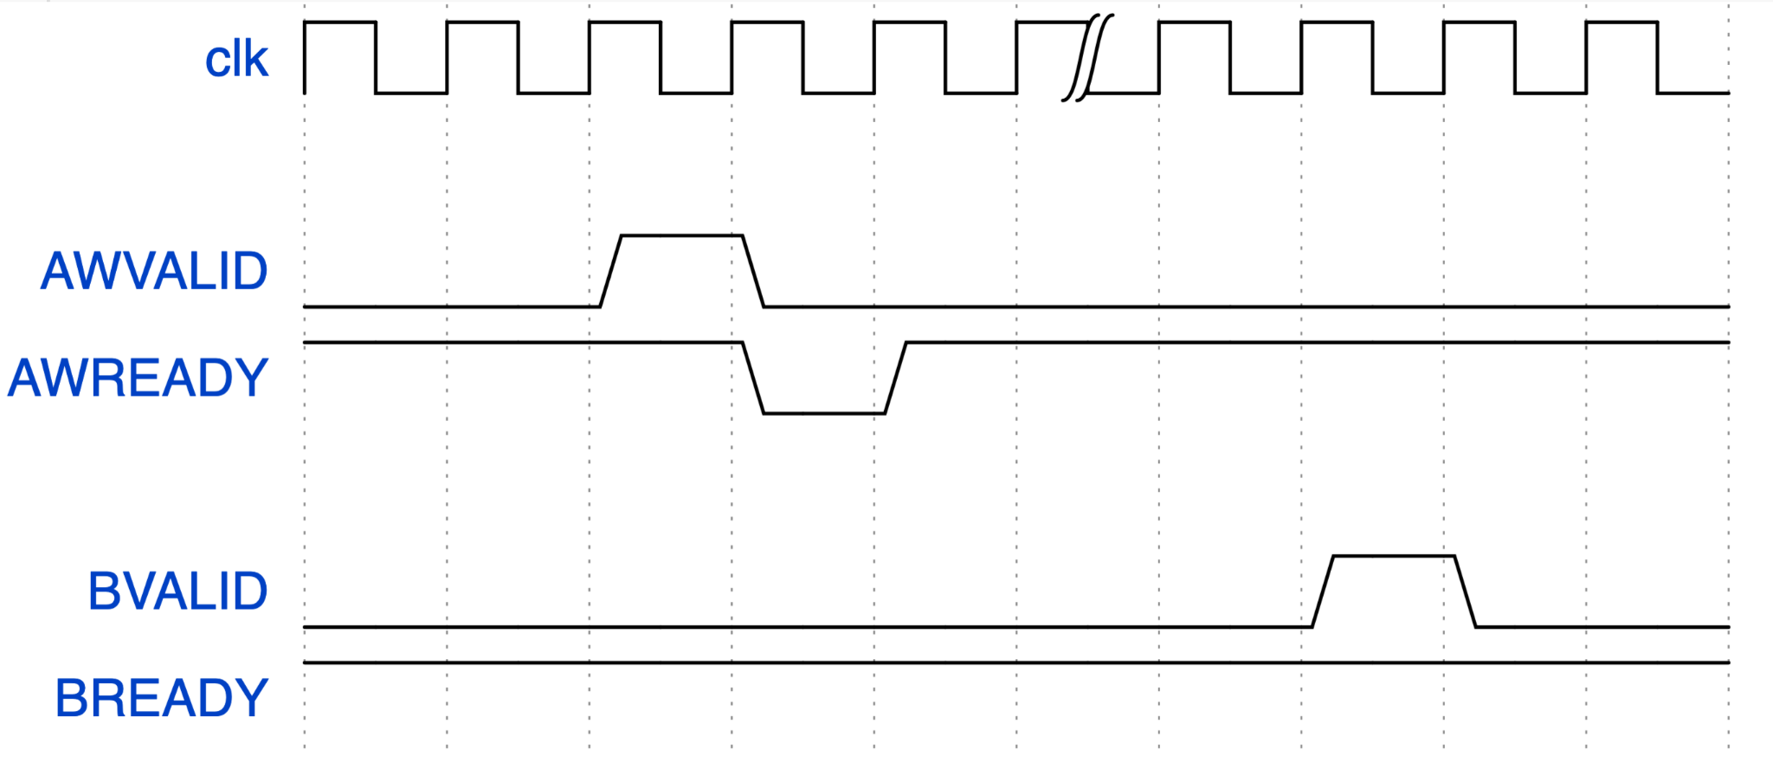
Write Side-channel
We focused on the write transaction of the AXI protocol.
The write handshake length depends on the data location in cache:
Data in L1 cache → 15+ cycles
Data in L2 cache → 14 cycles

Slide 20
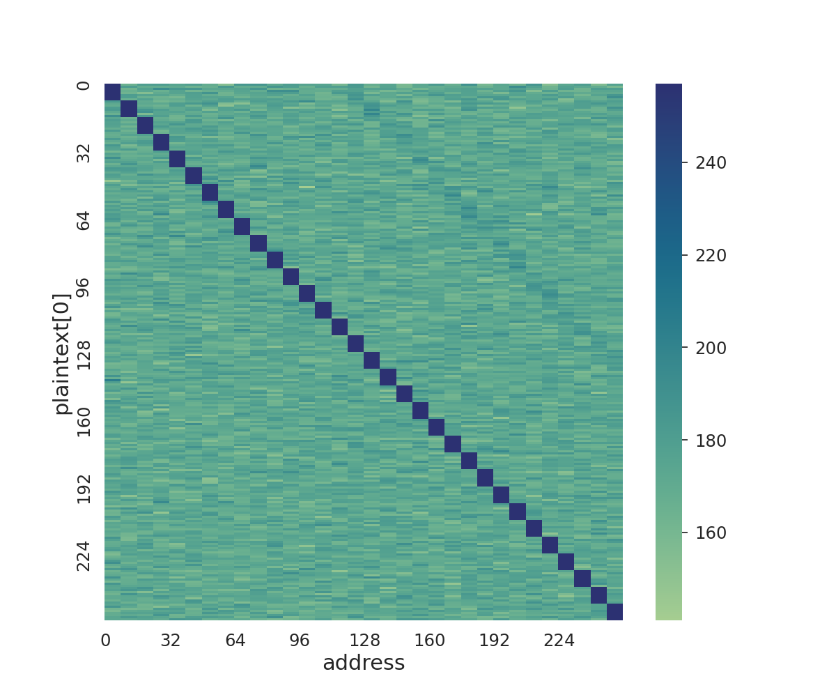
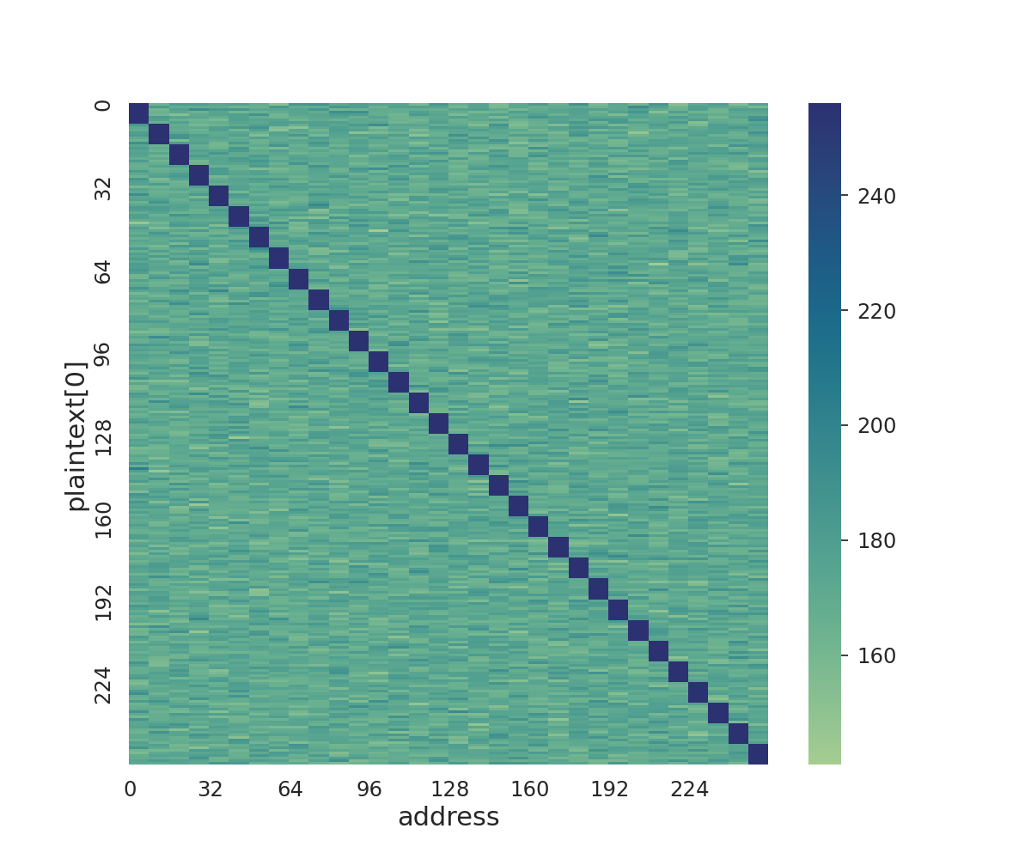
Write Channel Attack Results
Slow version
Optimized version
Notes:
Optimized version only touches one address in each cache line, but the the data collection process is the same
The write version uses the eviction done without the strobe set to 0.

Slide 21
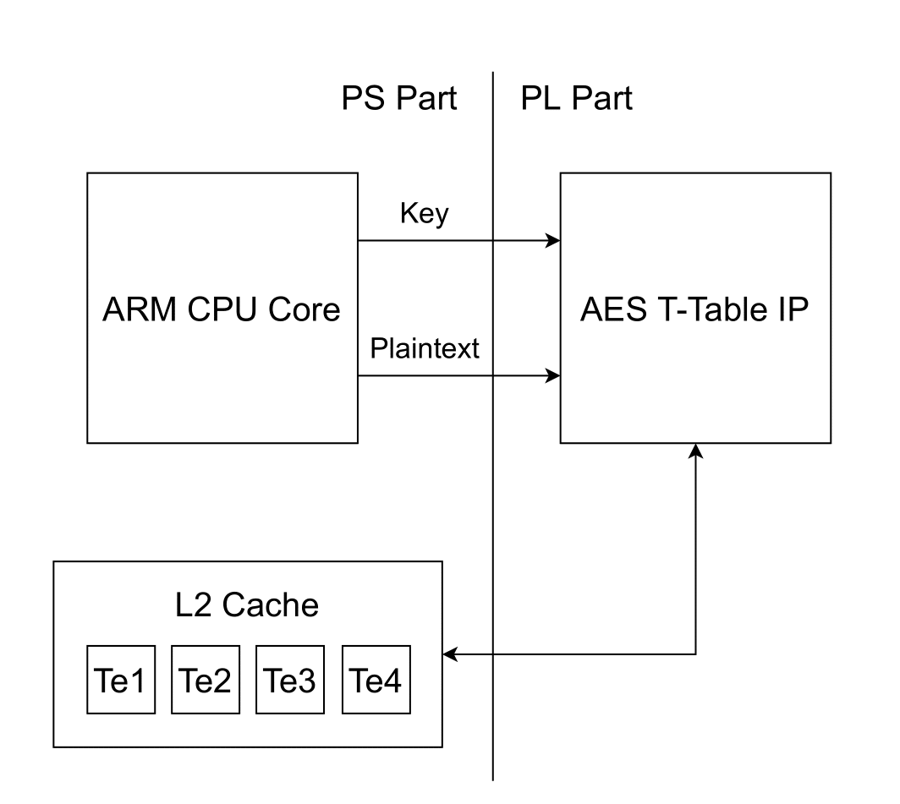
CPU to FPGA
T-Table implementation of AES as a custom IP
Tables are stored in shared memory (L2 cache)
Key and plaintext are provided by the user
We implemented a timer on the ARM CPU to time accesses to shared T-Tables
Notes:
Check that tables fits in fpga side

Slide 22
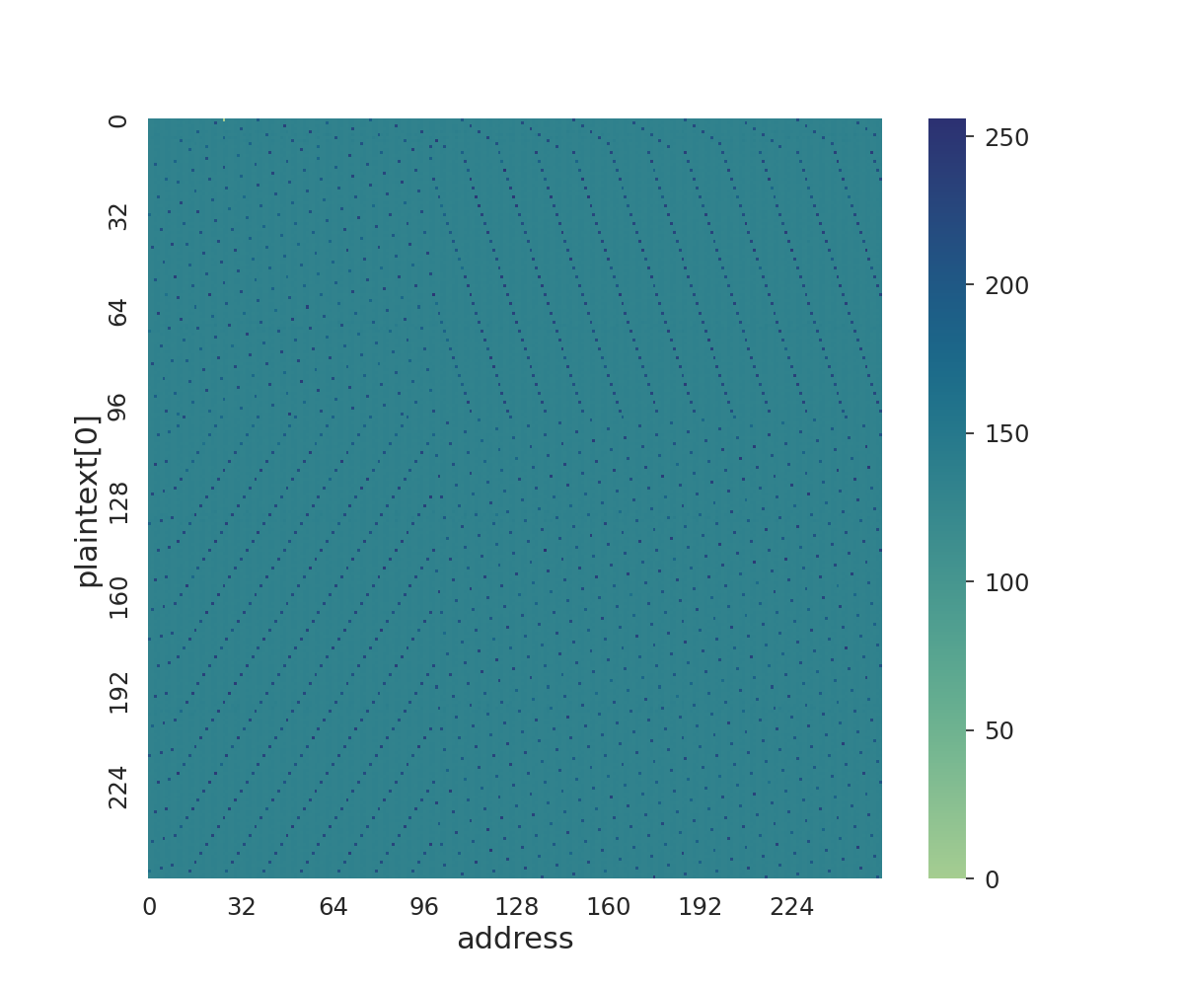
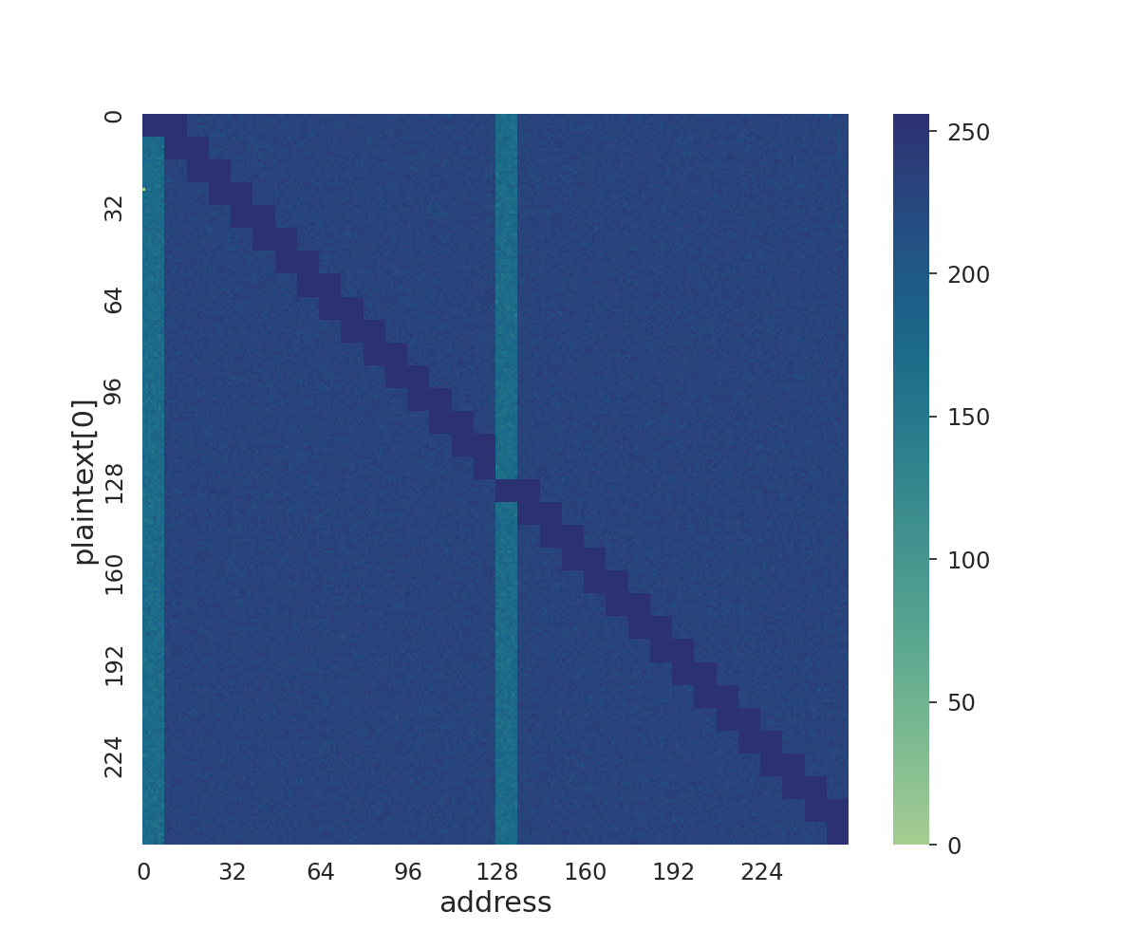
CPU to FPGA Attack Results
Memory Pattern
Attack Results

Slide 23
Conclusions
We assessed the work done by Bossuet et al. showing the feasibility of a key recovery attack on the T-Table implementation of AES
We found a new side channel on the write transaction
We replicated the attack on AES
We built an optimized version of that attack
We tested the attack on a different threat model: CPU to FPGA
Notes:
mention that axi is fully explored.

Slide 24

Thank You!
For more information please contact me at matteo.oldani@epfl.ch

Slide 25
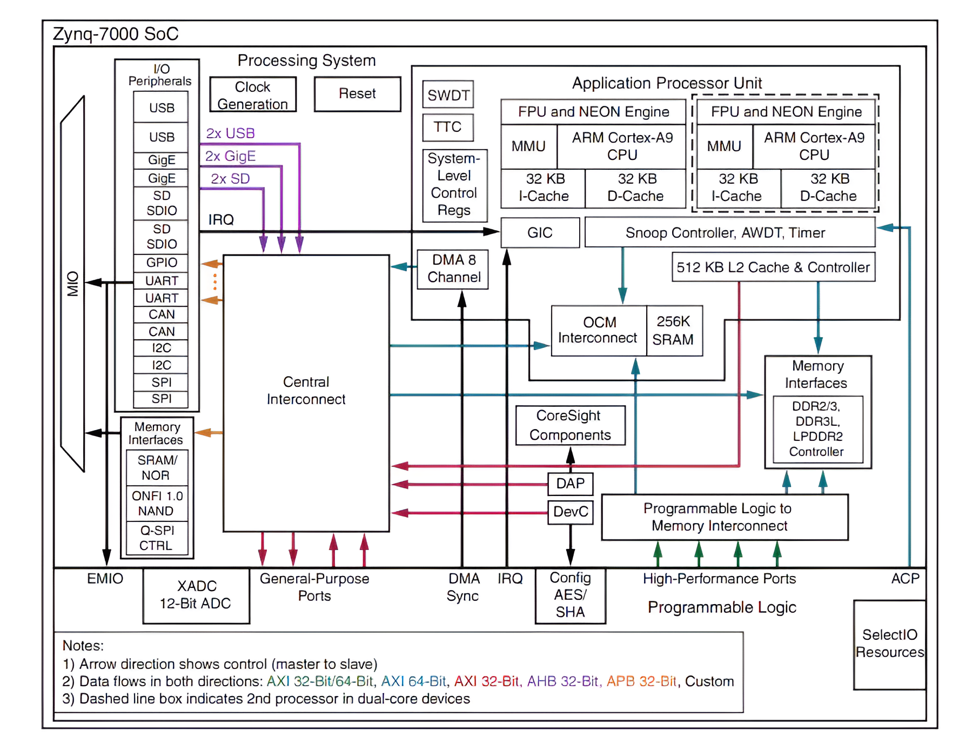
Complete Experimental Setup
Notes:
Describe the picture quickly
Describe the cache hierarchy
Descrive AXI and ACP port

Slide 26
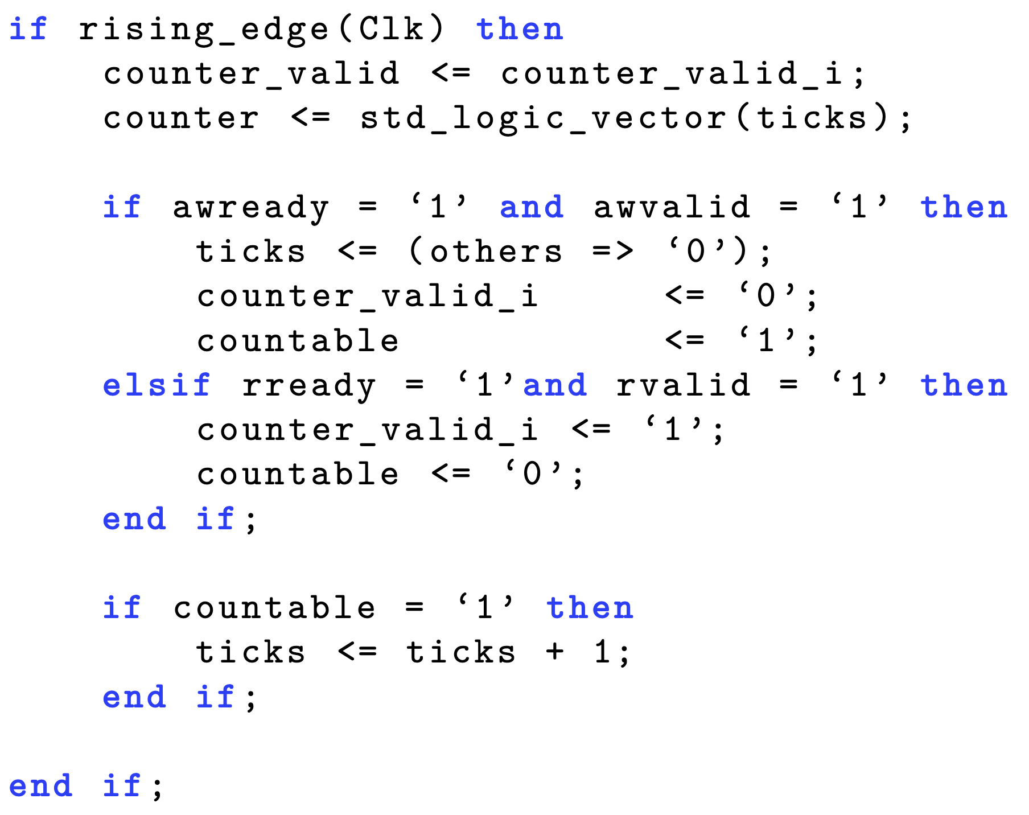
VHDL Timer

Slide 27
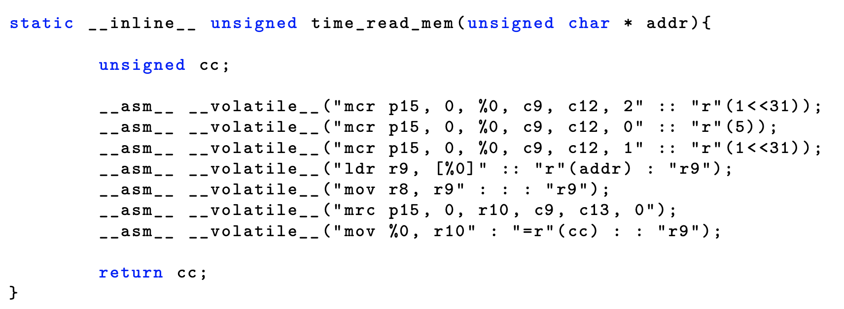
ARM Timer

Slide 28
Related Work
Beyond Cache Attacks
JackHammer
The work done by Sepúlveda et al. exploited contention on the bus-based SoC communication to execute the attack exactly after the first round of encryption.
Weissman et al. analysed rowhammer and cache attacks on Intel based SoCs. In particular their work showed cache attacks on inclusive last level of caches opening the possibility for PRIME + PROBE attacks.

Slide 29
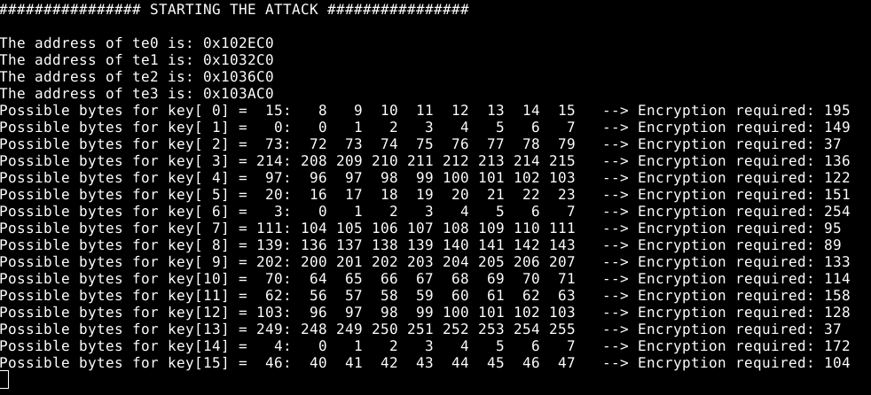
Attack Example

